Slide 1
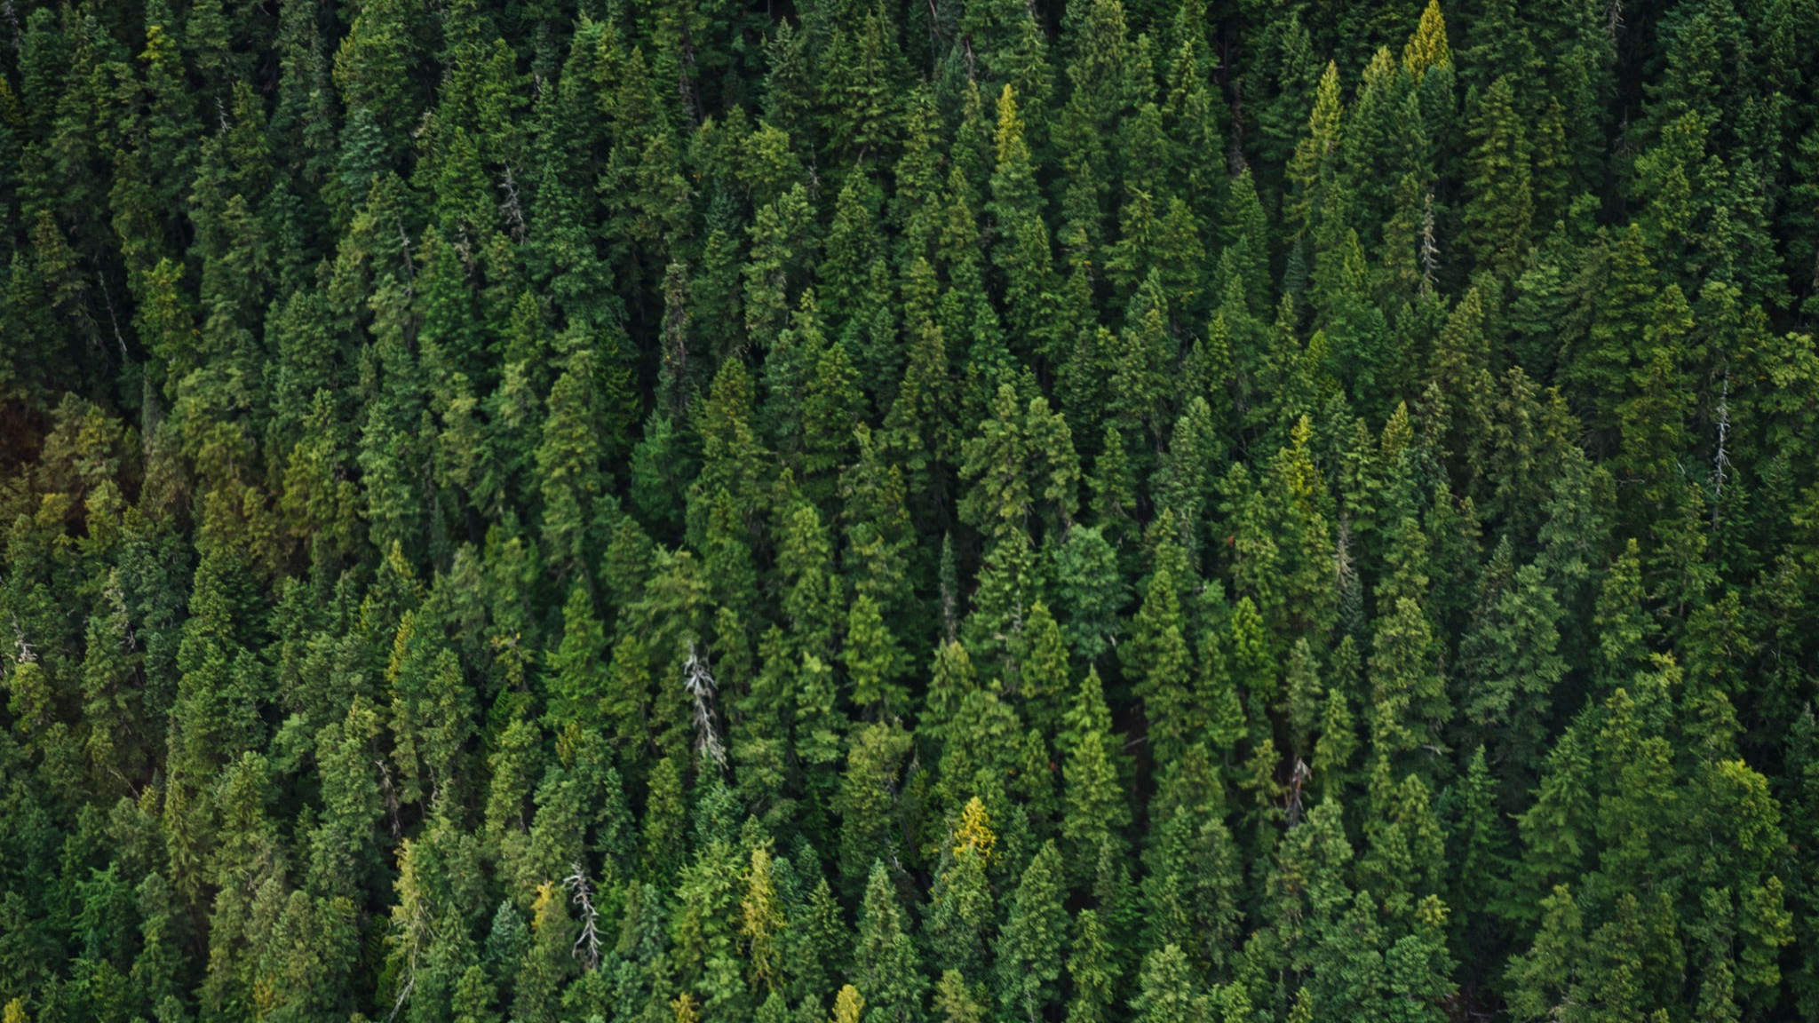
Invasive Species Detection
Olivia Gette,
Erica Zhu,
Zoe Mazurkiewicz
EET4501 Applied Machine Learning
Dr. Amna Mazen
Wednesday, April 16, 2025
Notes:
Erica

Slide 2
Project Objective
Statement
Importance
Target Output
How accurately can invasive plants be identified by using machine learning?
As climate change continues to degrade our planet, invasive species are spreading more rapidly, taking out the native species in the area. This can harm natural habitats all over the world, decreasing biodiversity and affecting the economy and human health[1].
Having one specific model that will accurately determine which plant species are invasive versus non-invasive.
Notes:
Erica

Slide 3
Dataset Description
The dataset that we are using comes from Kaggle[2]. There are a total of 2295 images in this dataset, which is considerably small. Each image contains an image of a Brazilian plant and is either labeled as invasive or non-invasive.
Initially, the data was split weirdly: the training set contained all of the images, then the testing set uses about 67% of the images in the testing set. So there were no unique images for the testing set. This was concerning because testing requires data that it has never seen before, so this might cause the algorithm to have incorrect accuracy and recall.
The training set of images are also weighted heavily towards invasive. When training, we added weights to non-invasive class of the dataset to obtain better accuracy and recall for the non-invasive class.
1448
847
Non-Invasive
Invasive
Notes:
Zoe

Slide 4
Dataset Preparation & Preprocessing
The dataset was uploaded directly from Kaggle instead of mounting our drive.
Uploaded only the training folder, which had all 2295 images in it
Loaded the labels
Checked how many images were invasive vs. noninvasive
Split the data into 80% training and 20% testing (set seed 42 for reproducibility)
Split train data set into 80% training and 20% validation (set seed 42)
No augmentation was done on the validation and test data
To obtain more variability in images, augmentation was done on training data
Class weights were computed since we had a low number of images for non-invasive
Notes:
Erica

Slide 5
Algorithms Tested
Machine Learning Models Applied (all CNN models)
InceptionV3
VGG16
MobileNet
DenseNet
Custom Model
Uses 3 convolutional layers (increasing filters 32, 64, 128) and 2 dropout layers (256 and 128 neurons) to reduce overfitting
Hyperparameter Tuning
Learning Rate: optimized using the Adam optimizer
Dropout Rate: set to 50% for regularization in Custom model
Classification Threshold: tested at threshold of 0.4 and 0.7 for comparison
Batch Size and Epochs: batch size of 32 and early stopping for epochs (max 20)
Notes:
olivia

Slide 6
Performance Evaluation Metrics
Accuracy
Measures proportion of correct predictions across all samples
Precision
Evaluates how many of the predicted positive cases (invasive) are actually correct
Recall
Examines how many true positive cases are correctly identified by the model
F1-Score
Combines precision and recall into a single score
Confusion Matrix
Breakdown of the model predictions, shows true positives, true negatives, false positives, and false negatives. Gives insight into classification performance
Did everything for both a 0.4 threshold to aid recall and a 0.7 threshold to aid precision to see if that would change the better performing model
Notes:
Zoe

Slide 7
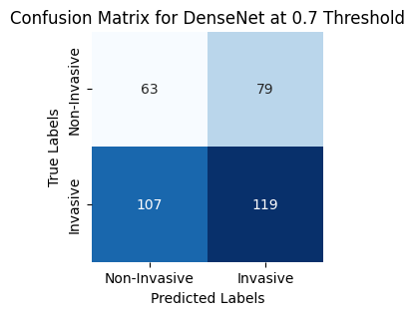
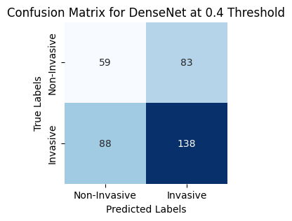
Threshold Comparison
0.4 Threshold
Precision
Highest: DenseNet (0.624)
Balances false positives decently
Recall
Highest: Custom (0.611)
Least false negatives
F1 Score
Highest: DenseNet (0.617)
Confusion Matrix
DenseNet prioritized recall
Favors recall, ensures maximum invasive plant detection
Ultimately, the
best for our
project
0.7 Threshold
Precision
Highest: MobileNet (0.648)
Better precision because of fewer false positives, sacrifices recall
Recall
Highest: Custom (0.549)
F1 Score
Highest: Custom (0.588)
Confusion Matrix
DenseNet had a lower recall score (0.527)
Improves precision overall, reducing false positives, but potentially misses invasive plants
Notes:
Erica
We compared thresholds 0.4 0.7
between the two confusion matrices we can see that the 0.7 threshold did worse
and that is because while precision improved, the recall and f1 score was worse. our best model was densenet

Slide 8
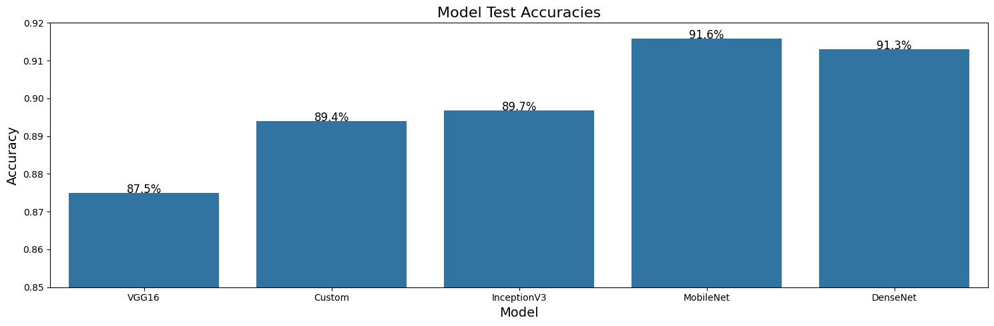
Result Comparison Chart
MobileNet Model:
Highest Accuracy (91.6%) → balances predictions for invasive and non-invasive plants
Highest Precision (0.648 for 0.7 threshold) → minimizes false positives, reduces incorrect predictions
Recall (0.553 for 0.4 threshold) → misses more invasive plants than the other models
Ideal for minimizing false positives
Custom Model:
Highest Recall (0.611 for 0.4 threshold) → true positives
Highest F1 score (0.588 for 0.7 threshold) → strongest balance between precision and recall
Second Lowest Accuracy (89.4%)
Ideal for detecting as many invasive plants as possible
DenseNet Model:
Highest Precision (0.624 for 0.4 threshold) → almost all invasive plants detected
Highest F1 score (0.617 for 0.4 threshold)
Second Highest Accuracy (91.3%)
Ideal for general classification in detecting invasive plants effectively, which is our goal
Notes:
olivia

Slide 9
Result Comparison cont.
InceptionV3 Model:
Second highest precision (0.616 at 0.4)
Second lowest recalls (0.597 and 0.518) → not high for invasive plant detection
Second lowest F1 scores (0.607 and 0.559) → weaker balance between precision and recall
Third Highest Accuracy (89.7%)
Limitations
Threshold Sensitivity: performance dropped significantly at a 0.7 threshold, reducing recall even more
Complex Architecture for Small Datasets: designed for large-scale datasets, making it harder to generalize well to our dataset
VGG16 Model:
Second lowest precision (0.613 and 0.616)
Lowest recall (0.504 at 0.7)
Second highest F1 score(0.612 at 0.4)
Lowest Accuracy (87.5%)
Limitations
High Risk of Overfitting: prone to memorizing the data rather than generalizing
Less Efficient Feature Extraction: lacks advanced techniques like feature reuse (DenseNet) or optimized convolutions (MobileNet)
Why The Other Three Worked Better:
DenseNet: feature reuse improves generalization and balances precision and recall
MobileNet: lightweight and optimized for resource-efficient classification
Custom Model: prioritizes recall, minimizing false negatives to detect invasive species effectively
Notes:
Zoe

Slide 10
Future Work
Use a different threshold that’s better suited for the data
Work on obtaining a large image dataset from Michigan of all of the invasive species and non-invasive species to make what we’ve done more applicable to this area
Create an app with the algorithm chosen to use to see what plants are invasive or not.
Invasive species mapping using remote sensing (decision boundaries)
Notes:
Olivia

Slide 11
References
[1] USDA. (n.d.) Human Health Impacts. National Invasive Species Information Center. https://www.invasivespeciesinfo.gov/subject/human-health-impacts#:~:text=Invasive%20species%20can%20negatively%20impact,2013).
[2] Kan W. (2017). Invasive Species Monitoring. [Dataset]. https://www.kaggle.com/competitions/invasive-species-monitoring/data

Slide 12

Questions?

